Slide 1

Statistical Analysis of NBA Player Performance
Exploring the Relationship Between Efficiency Metrics and Team Success

Slide 2
Hypothesis and Variables:
Hypothesis: How do efficiency metrics correlate with team success?
Variables and Descriptions:
PPG (Points Per Game):
Average points scored by a player per game.
PER (Player Efficiency Rating):
Per-minute rating summarizing a player’s overall contributions.
TS% (True Shooting Percentage):
A shooting efficiency metric accounting for all scoring types.
AST% (Assist Percentage):
Percentage of teammate field goals assisted while on the floor.
USG% (Usage Percentage):
Percentage of a team’s possessions used by the player.

Slide 3
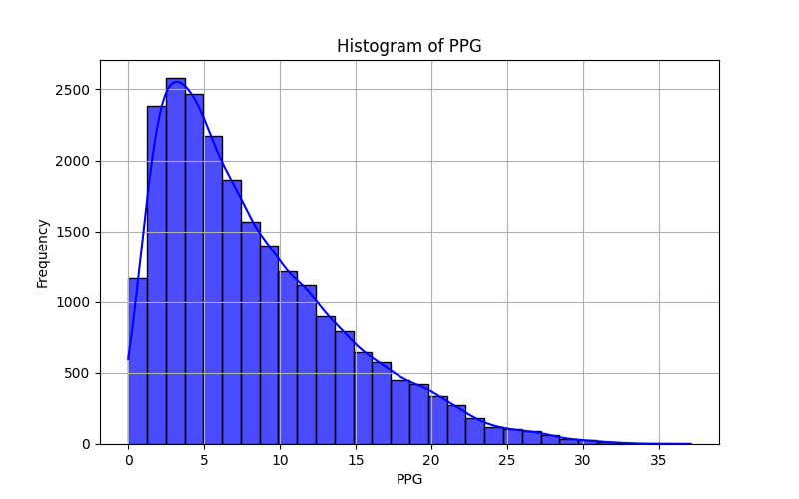
Descriptive Statistics PPG:
PPG:
Mean: 8.18
Median: 6.66
Std Dev: 5.98
Tails (5th & 95th percentiles): [1.22, 20.105]
Interpretation:
Distribution is right-skewed, with most players scoring fewer points and a small number of high-scoring outliers

Slide 4
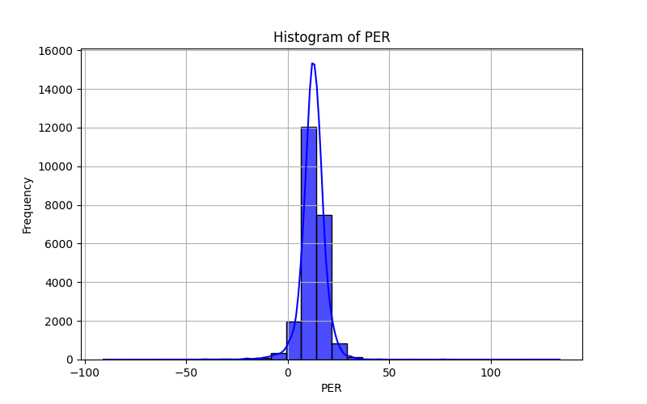
Descriptive Statistics PER:
PER:
Mean: 12.50
Median: 12.70
Mode: 11.80
Std Dev: 6.23
Tails (5th & 95th percentiles): [3.6, 21.1]
Interpretation:
Distribution is approximately normal, indicating that most players have moderate efficiency ratings.

Slide 5
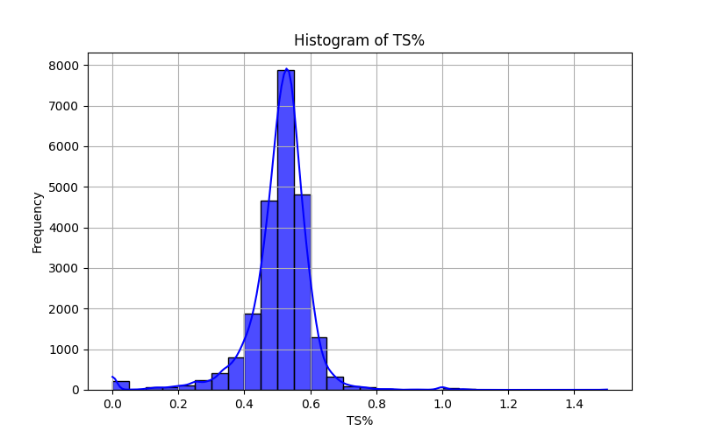
Descriptive Statistics TS%:
TS%:
Mean: 0.51
Median: 0.52
Mode: 0.50
Std Dev: 0.10
Tails (5th & 95th percentiles): [0.356, 0.618]
Interpretation:
Distribution is centered around the mean indicating a relatively narrow spread of shooting efficiency for most players

Slide 6
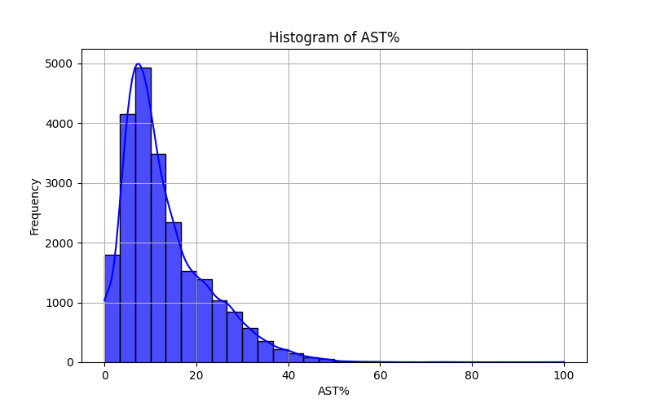
Descriptive Statistics AST%:
AST%:
Mean: 13.11
Median: 10.40
Mode: 0.00
Std Dev: 9.38
Tails (5th & 95th percentiles): [ 2.4, 31.7]
Interpretation:
Distribution is right-skewed, showing that most players have low assist percentages while a few have high assist rates.

Slide 7
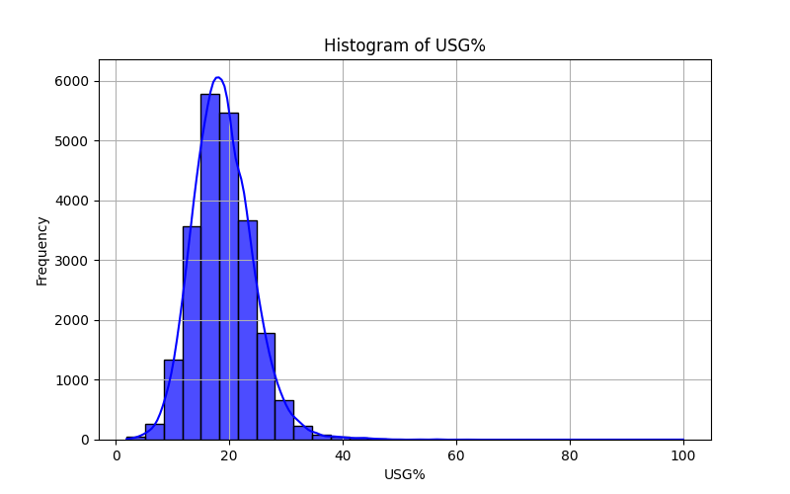
Descriptive Statistics USG%:
USG%:
Mean: 18.90
Median: 18.50
Mode: 19.10
Std Dev: 5.38
Tails (5th & 95th percentiles): [11.0, 27.9]
Interpretation:
Distribution is mostly normal, indicating that most players have moderate involvement in team possessions, with a few outliers having higher usage rates.

Slide 8
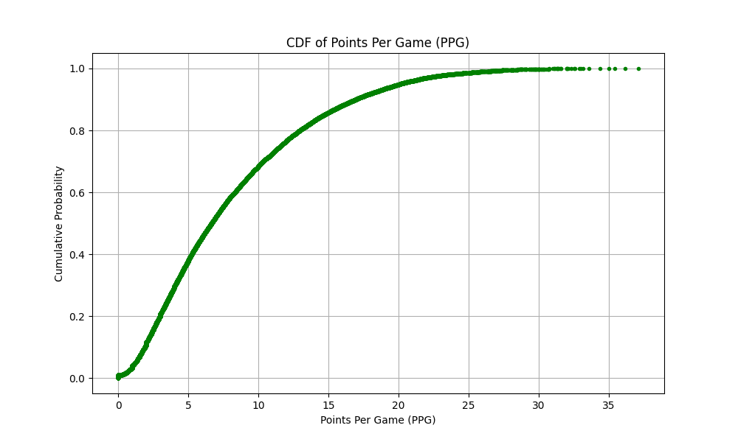
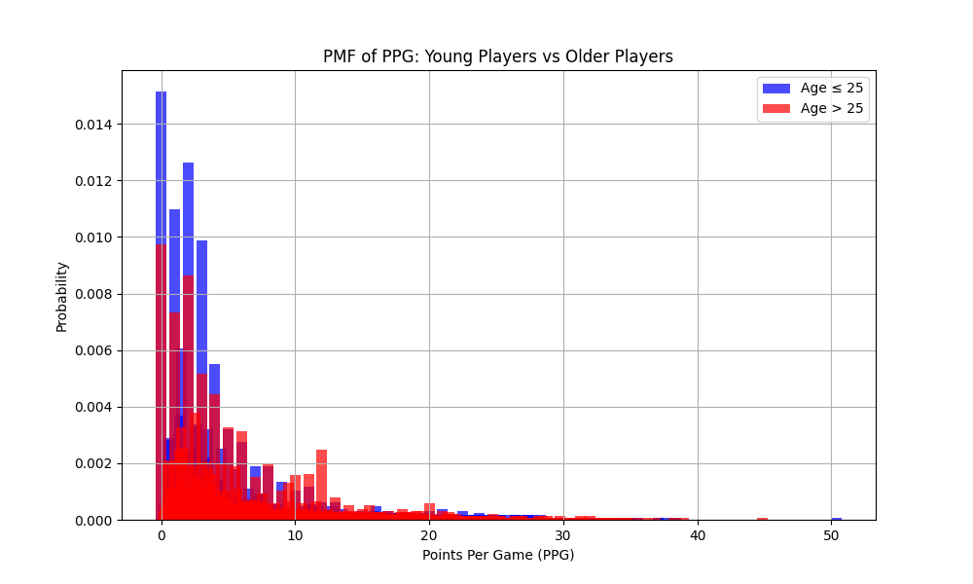
PMF and CDF Analysis
PMF highlights PPG differences between younger and older players.
Players (≤ 25) are more likely to score fewer points per game than older players, with the distribution tapering off significantly for both age groups beyond 10 PPG.
CDF of PPG:
This plot indicates that 50% of players score fewer than 6.66 PPG, while only 10% exceed 16.94 PPG.

Slide 9
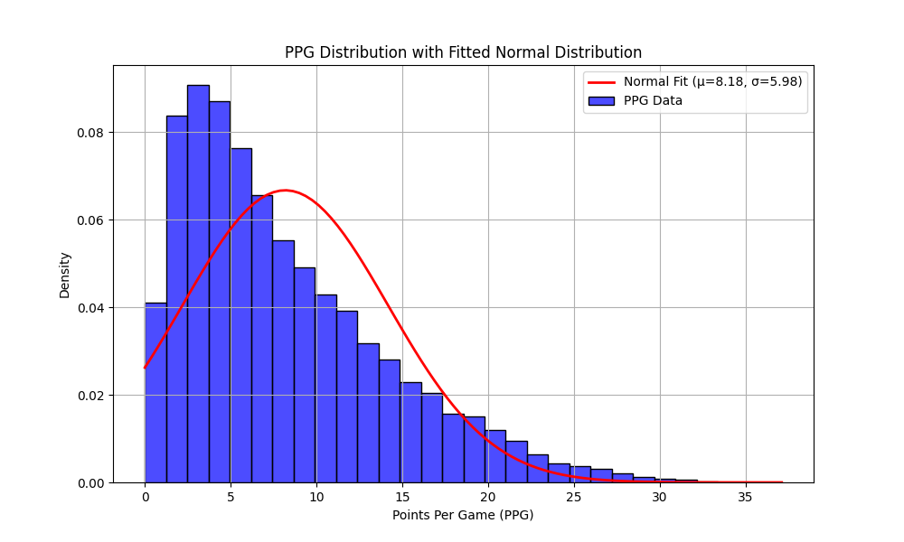
Normal Fit Distribution
The normal distribution fit highlights the central tendency of PPG but shows a right skew due to high-scoring outliers.
Most players score around the mean, while elite scorers (>25 PPG) deviate from the normal trend.

Slide 10
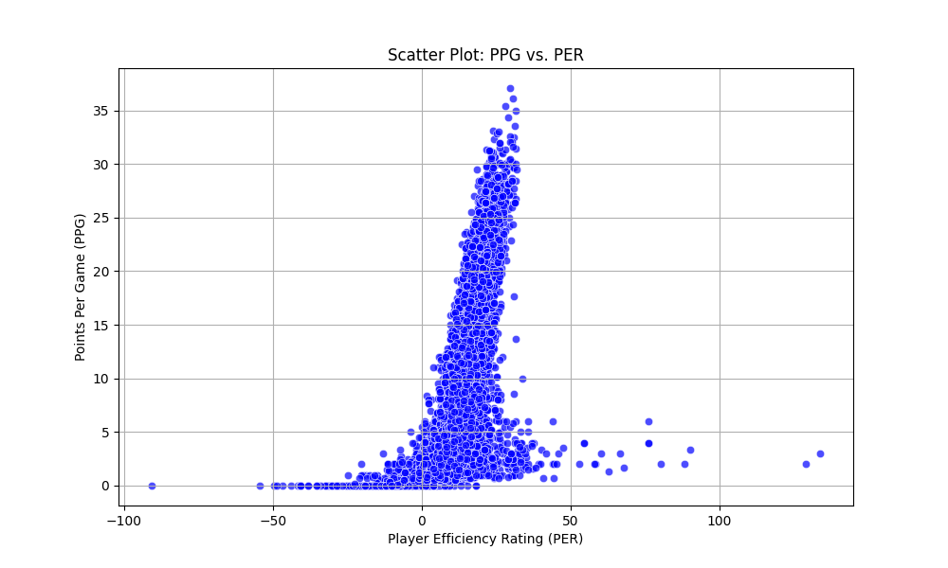
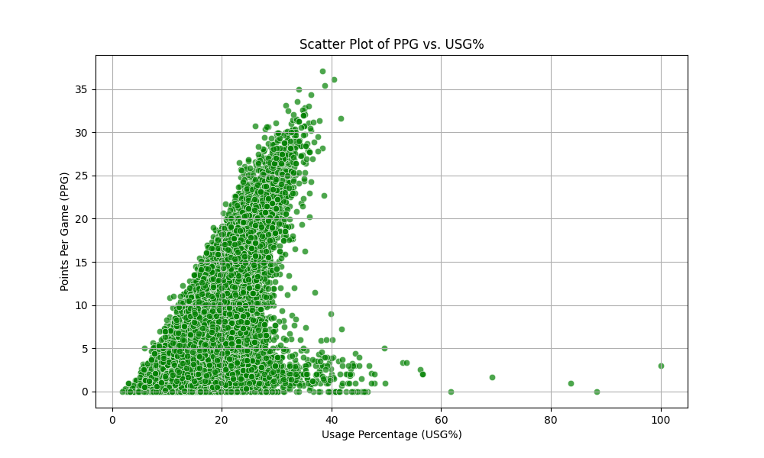
Scatter Plot Analysis
Scatter Plot: PPG vs PER:
The plot shows a positive linear relationship between PPG and PER, with a Pearson's correlation of 0.62, indicating that higher player efficiency is associated with higher scoring.
The covariance (22.97) reinforces this positive association, though some variability exists due to players with low PER scoring more or less than expected.
Scatter Plot: PPG vs USG%
This plot illustrates a positive relationship between PPG and USG%, with a Pearson's correlation of 0.55, suggesting that increased usage percentage contributes to higher scoring.
The covariance (17.61) supports this relationship, but the spread of points indicates that not all high-usage players score heavily, reflecting variability in scoring efficiency.

Slide 11
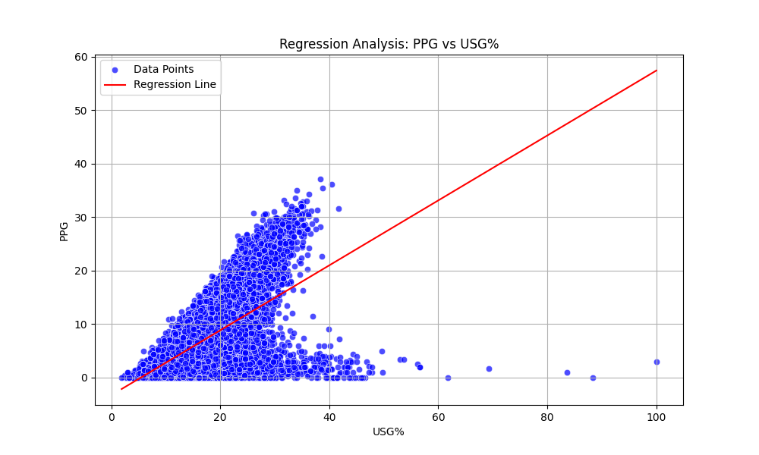
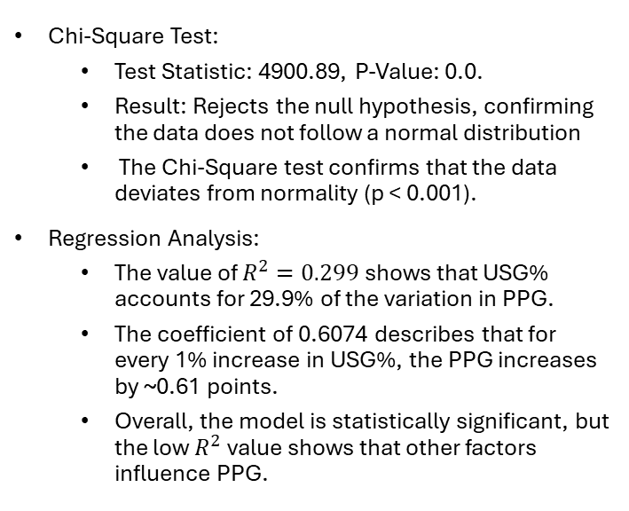
Chi-Square and Regression Analysis
Chi-Square Test:
Test Statistic: 4900.89, P-Value: 0.0.
Result: Rejects the null hypothesis, confirming the data does not follow a normal distribution
The Chi-Square test confirms that the data deviates from normality (p < 0.001).
Regression Analysis:
The value of $R^{2}=0.299$ shows that USG% accounts for 29.9% of the variation in PPG.
The coefficient of 0.6074 describes that for every 1% increase in USG%, the PPG increases by ~0.61 points.
Overall, the model is statistically significant, but the low $R^{2}$ value shows that other factors influence PPG.

